Slide 1
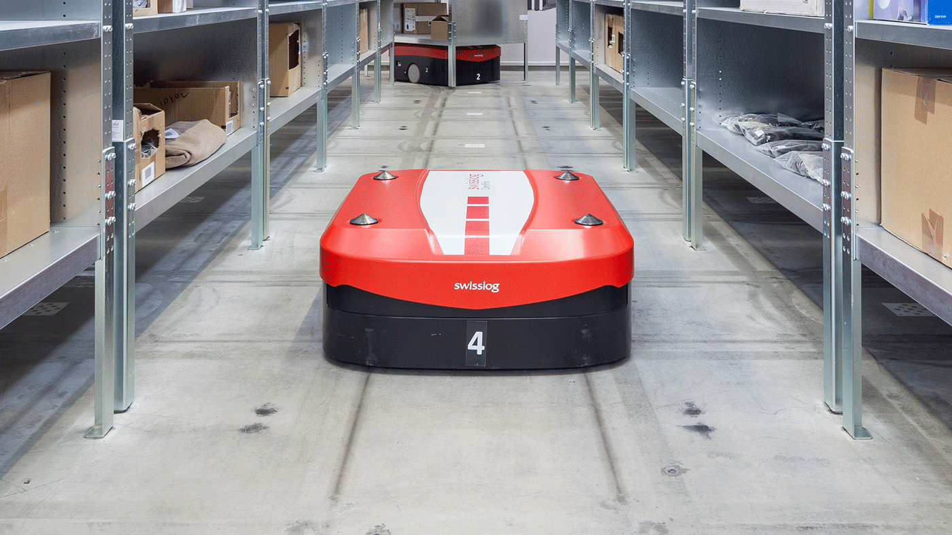
Autonomous Guided Vehicles (AGVs) and Autonomous Mobile Robots (AMRs)
Name: Amirul Haikal Bin Shahrin
Matric Number: 1912521

Slide 2
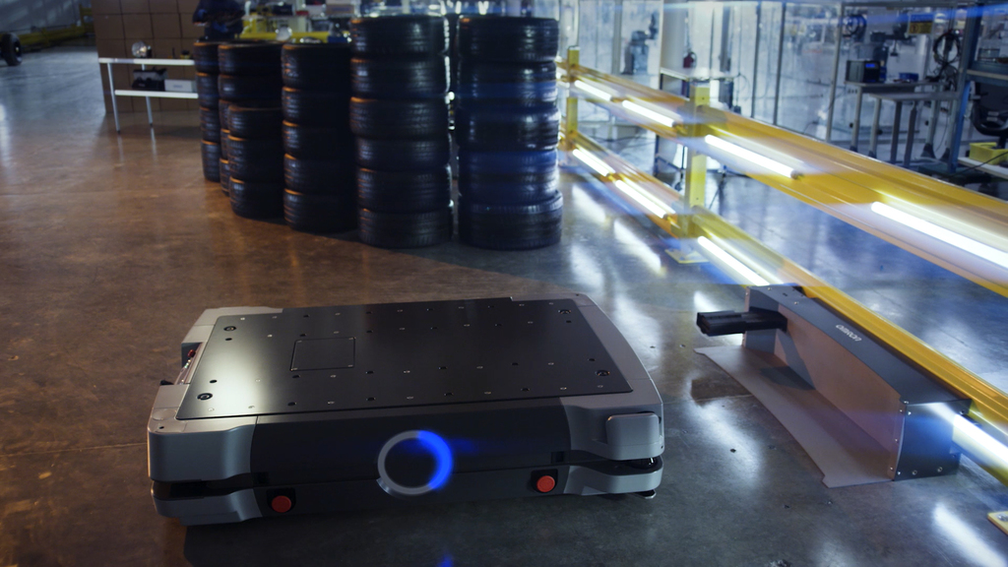
Introduction
Autonomous Guided Vehicles (AGVs) and Autonomous Mobile Robots (AMRs) are self-contained, mobile machines used for transportation and material handling purposes.
These machines rely heavily on hardware components to navigate, perceive their surroundings, and carry out their tasks.
The main difference between an AGV and an AMR is that AMRs use free navigation by means of lasers, while AGVs are located with fixed elements: magnetic tapes, magnets, beacons, etc. So, to be effective, they must have a predictable route.

Slide 3
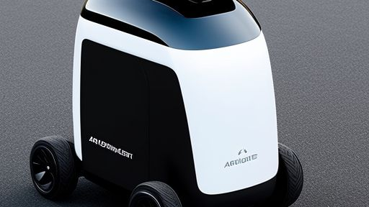
Main Components
Locomotion (Wheels, Tracks & Legs)
Control System (Microprocessors & Controllers)
Data Collection (Lidar, Vision & Ultrasonic Sensors)
Data Transmission (Wifi, Bluetooth, Cellular Modems & Ethernet Cable)
Actuation Hardware (Motors & Grippers)
Power Management (Batteries & Chargers)

Slide 4
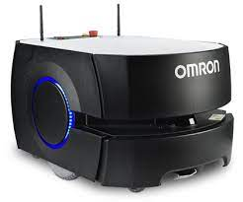
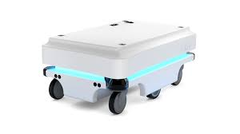
Locomotion (Wheels)
Omron Automation
MiR100
Wheels are the most common locomotion hardware used in AGVs and AMRs.
They are used for movement on smooth and flat surfaces.

Slide 5
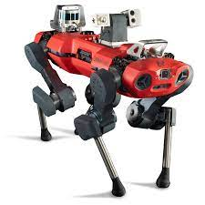
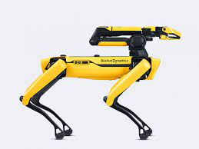
Locomotion (Legs)
Boston Dynamics Spot
ANYbotics ANYmal
Legged robots are becoming increasingly popular in the field of AGVs/AMRs.
They are used for navigating complex environments and overcoming obstacles.

Slide 6
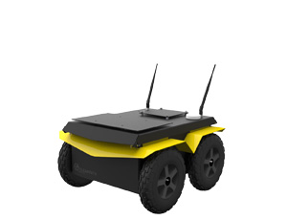
Locomotion (Tracks)
Clearpath Jackal
Tracks are used in AGVs/AMRs to provide better traction and stability on uneven and rough terrain.
One of the example of tracks used in AGVs/AMRs is Clearpath Jackal.

Slide 7
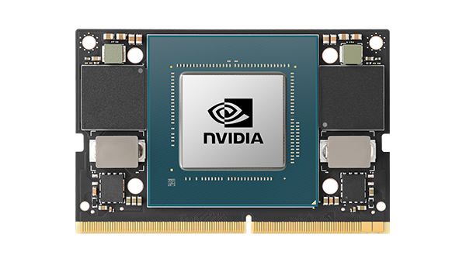
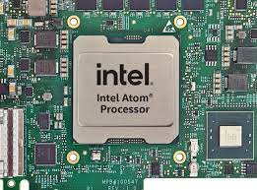
Control System (Microprocessors)
Microprocessors are used to process sensory information and make decisions in real-time.
They are used for navigation, obstacle avoidance, and control.
Examples of microprocessors used in AGVs/AMRs are Intel Atom and Nvidia Jetson.
Intel Atom
Nvidia Jetson

Slide 8
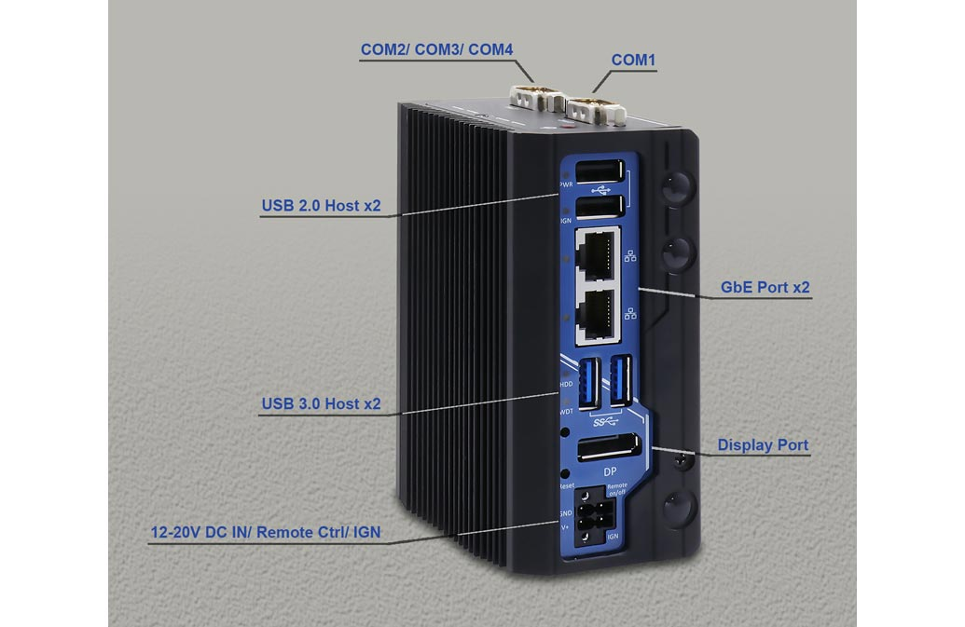
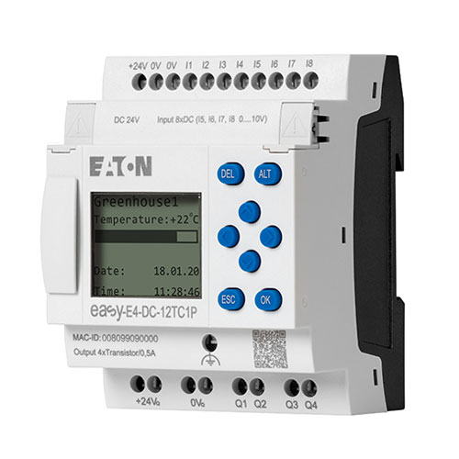
Control System (Controllers)
Controllers are used to manage the hardware components in AGVs/AMRs.
They are responsible for coordinating the movements of the vehicle, receiving and interpreting sensor data, and executing tasks.
Examples of controllers used in AGVs/AMRs are PLCs (Programmable Logic Controllers) and Embedded controllers.
Embedded Controllers
Programmable Logic Controllers (PLCs)

Slide 9
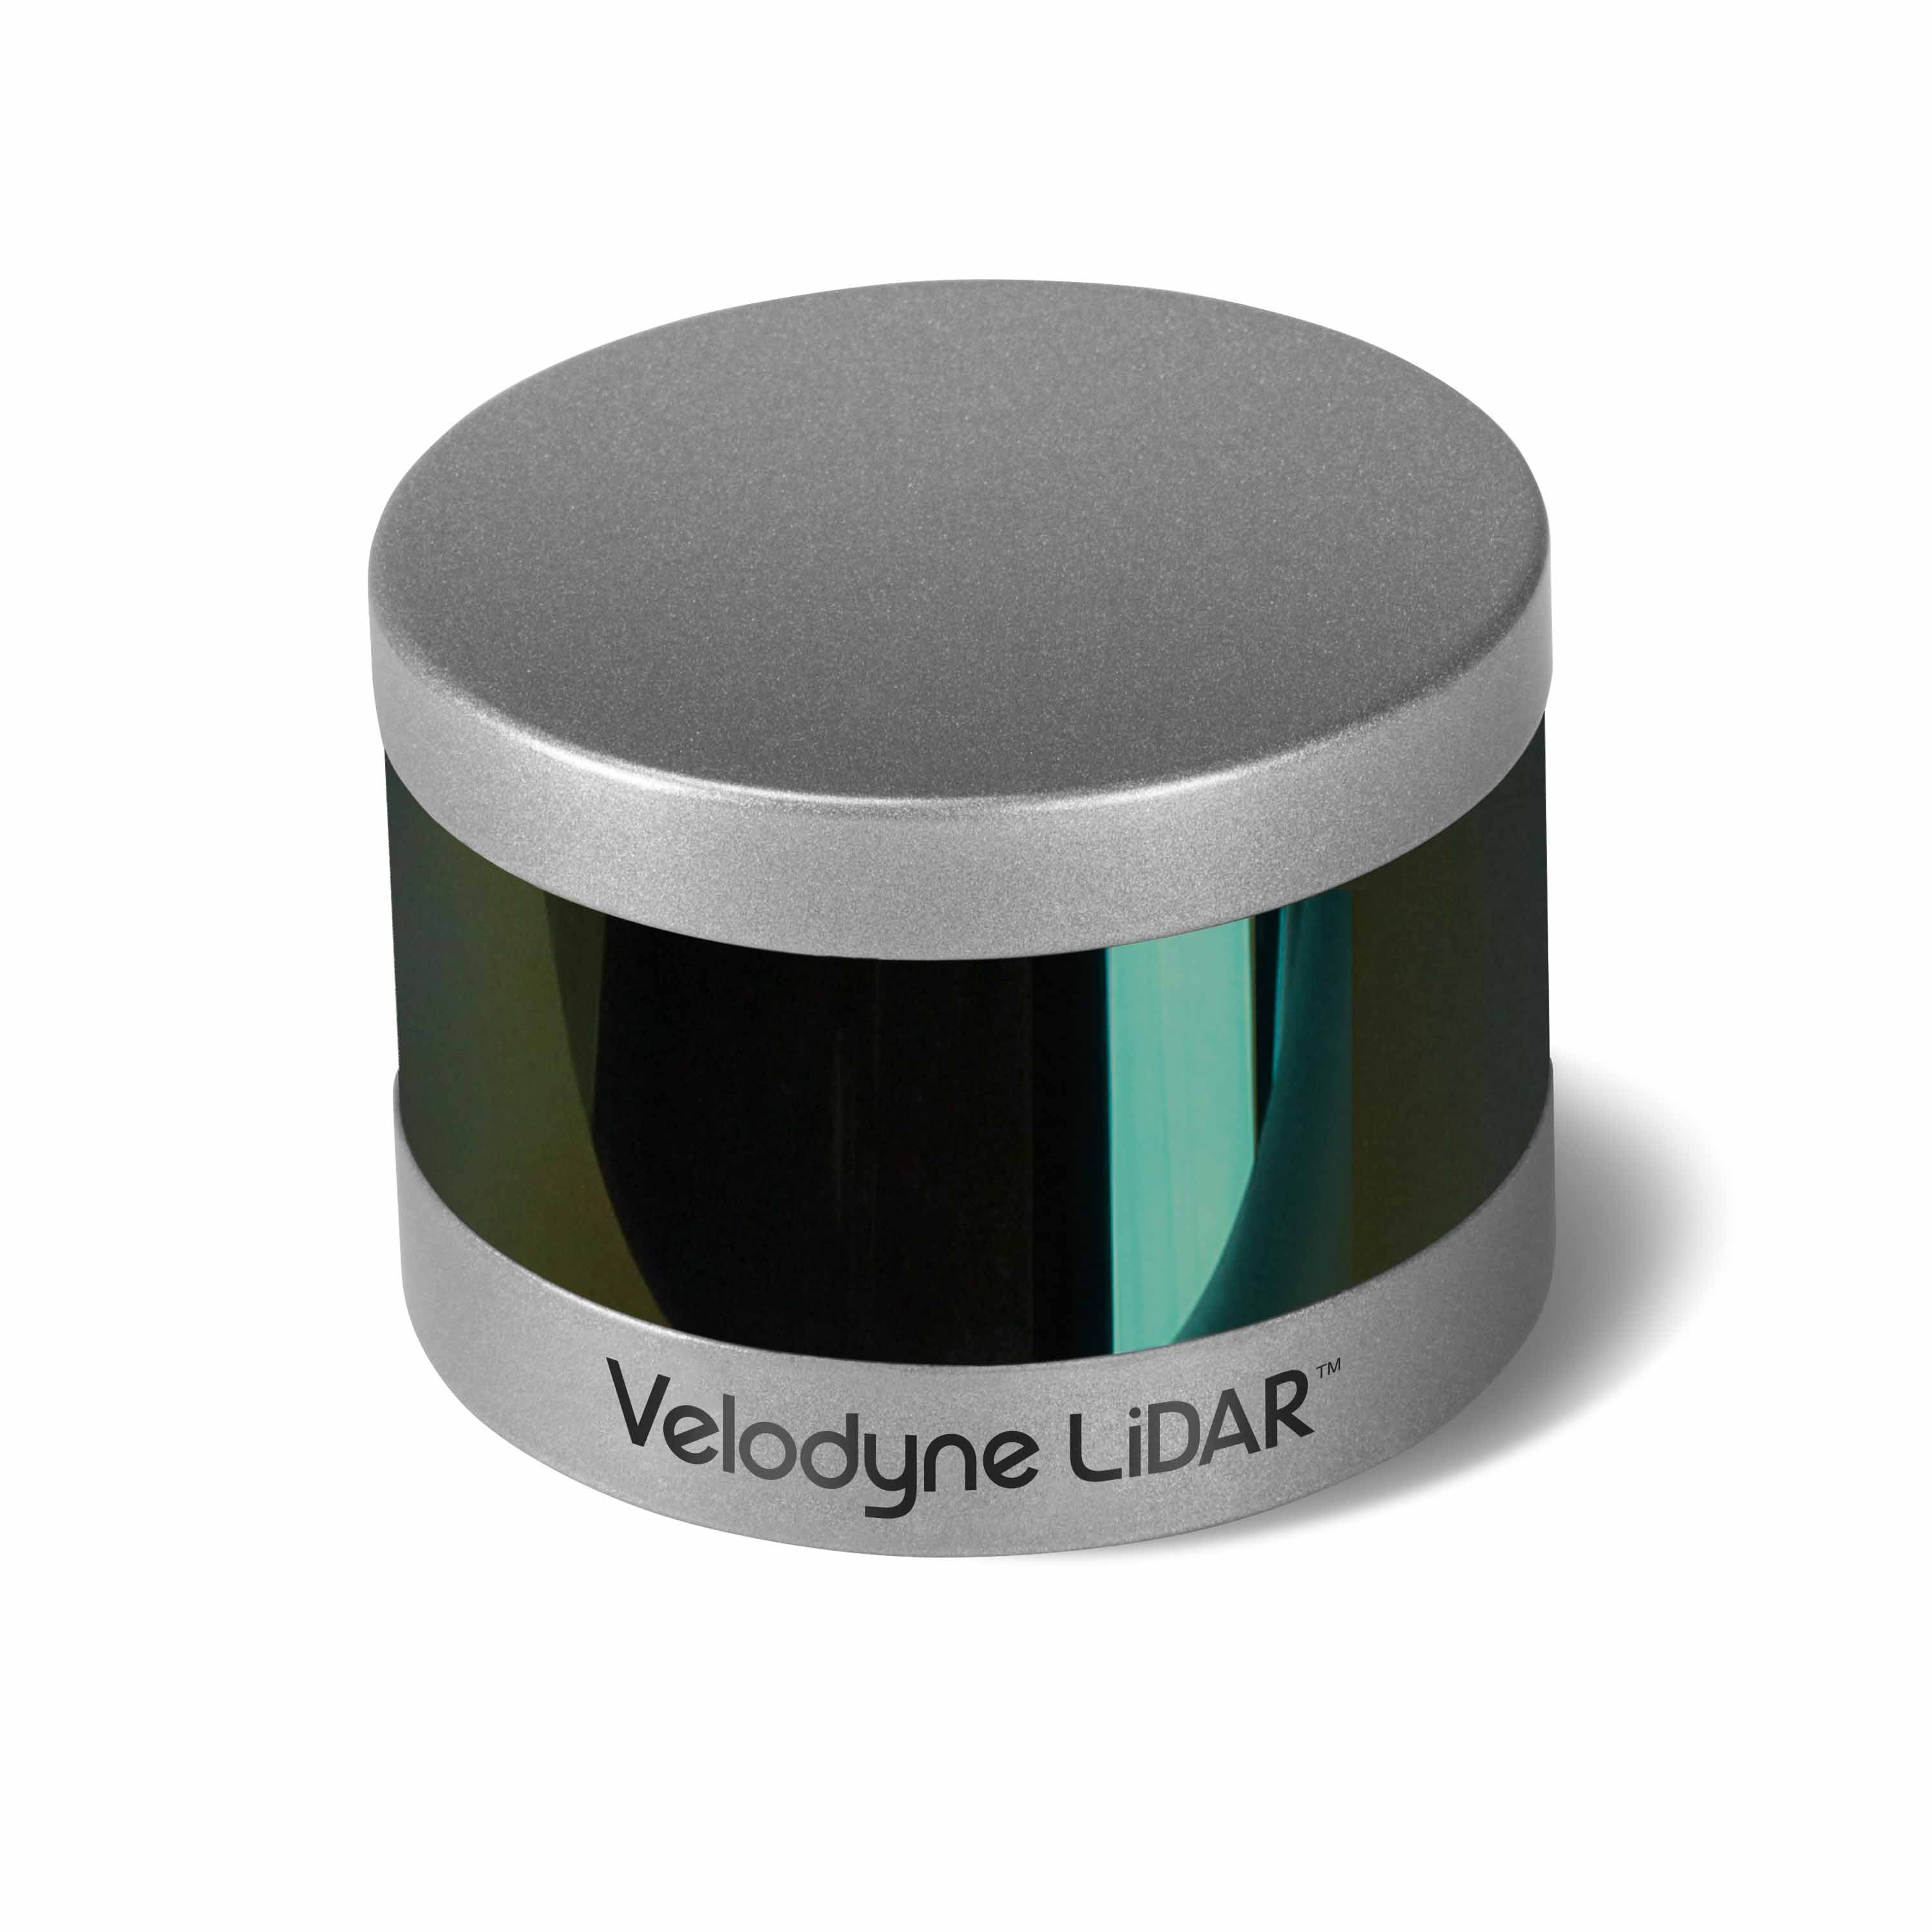
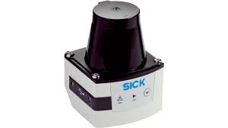
Data Collection (Lidar Sensors)
Lidar (Light Detection and Ranging) sensors are used to provide a 3D view of the environment around the AGV/AMR by using laser beams to detect the distance of objects.
Examples of Lidar sensors used in AGVs/AMRs are Velodyne Lidar and Sick Lidar.
Velodyne Lidar
Sick Lidar

Slide 10
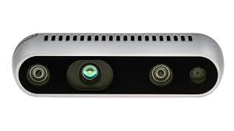
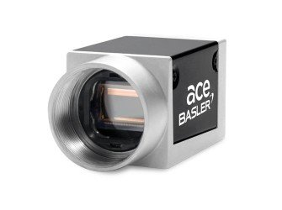
Data Collection (Vision Sensors)
Vision sensors use cameras to provide visual information to the AGV/AMR about its surroundings.
They are used for object detection, recognition, and tracking.
Examples of Vision sensors used in AGVs/AMRs are Intel RealSense and Basler Vision sensors.
Intel RealSense
Basler Vision sensors

Slide 11
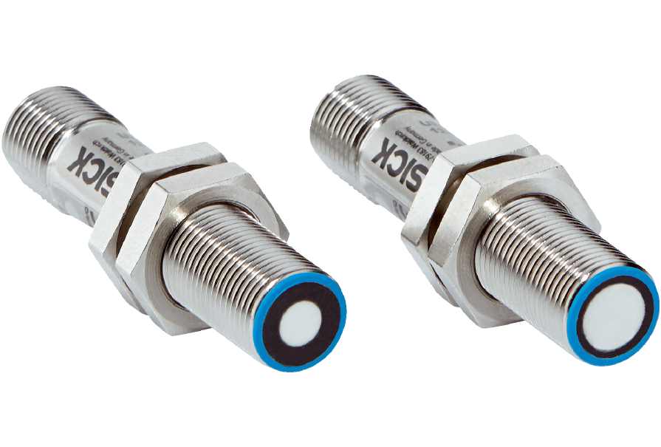
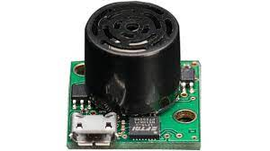
Data Collection (Ultrasonic Sensors)
Ultrasonic sensors use sound waves to detect the distance between the AGV/AMR and obstacles in the environment.
They are used for obstacle avoidance and positioning.
Examples of ultrasonic sensors used in AGVs/AMRs are MaxBotix and SICK Ultrasonic Sensors.
SICK Ultrasonic Sensors
MaxBotix

Slide 12
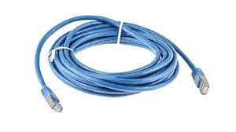
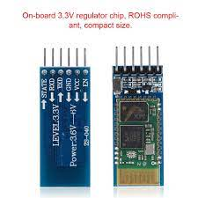
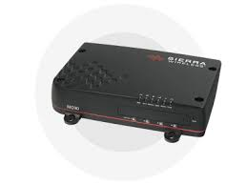
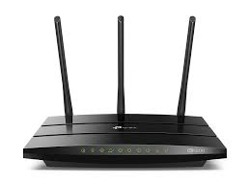
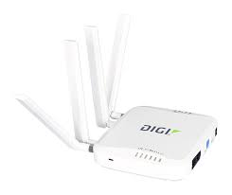
Data Transmission
Ethernet Cable
The data transmission hardware enables the vehicles to communicate with the control system and exchange information with other devices in the environment.
Wi-Fi: Wi-Fi is a commonly used wireless communication technology in AGVs/AMRs. It enables the vehicles to communicate with the control system and exchange data in real-time. Examples of Wi-Fi devices used in AGVs/AMRs are wireless routers and access points.
Bluetooth: Bluetooth is another wireless communication technology used in AGVs/AMRs. It is used for short-range communication between the AGV/AMR and other devices in the environment. Examples of Bluetooth devices used in AGVs/AMRs are Bluetooth sensors and tags.
Cellular Modems: Cellular modems are used to provide long-range communication in AGVs/AMRs. They use cellular networks to enable communication between the AGV/AMR and the control system. Examples of cellular modems used in AGVs/AMRs are Sierra Wireless modems and Digi International modems.
Ethernet: Ethernet is a wired communication technology used in AGVs/AMRs. It enables the vehicles to communicate with the control system using cables. Examples of Ethernet devices used in AGVs/AMRs are Ethernet switches and routers.
Bluetooth Module
Sierra Wireless Modem
Archer C1200 (WIFI)
Digi International modems.

Slide 13
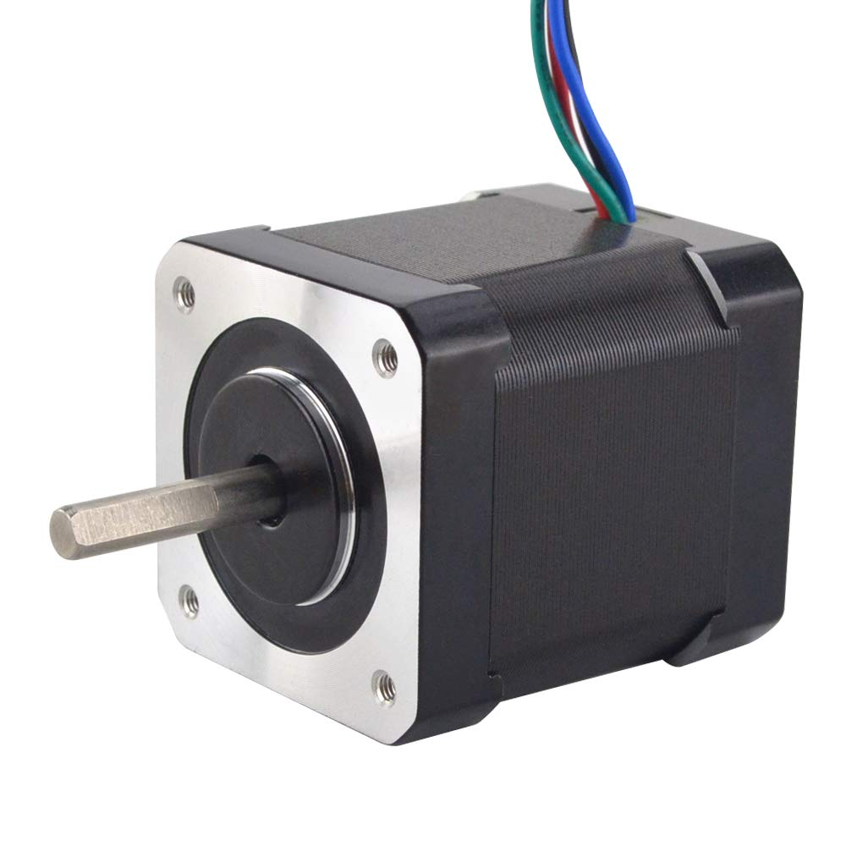
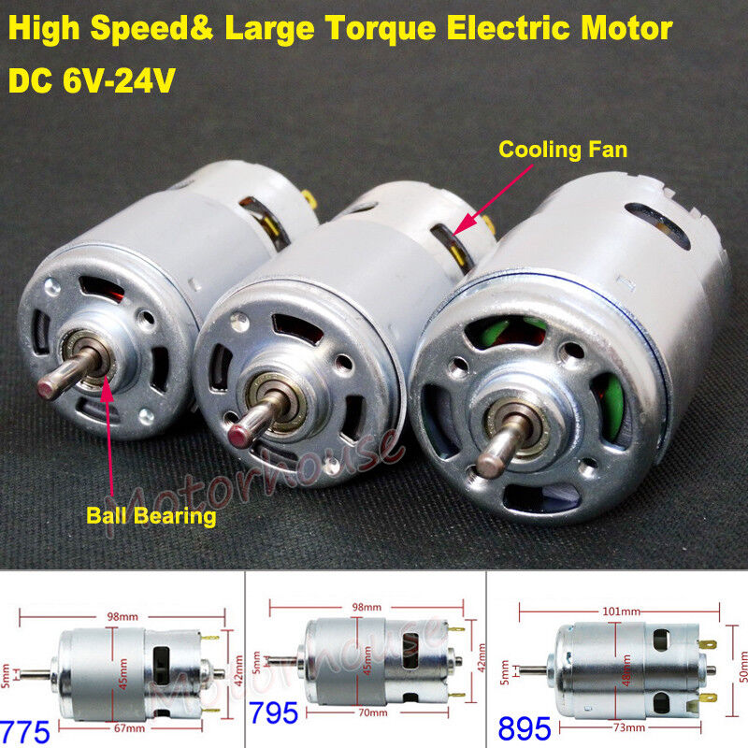
Actuators (Motors)
Stepper Motor Bipolar 2A 84oz.in 48mm 4-Lead
RS-775 Electric DC Motor
Actuation hardware is used in AGVs and AMRs to carry out the tasks assigned to them.
Motors are used to provide the necessary power to move the AGV/AMR.
They are used for propulsion, steering, and lifting.
Examples of motors used in AGVs/AMRs are DC motors and Stepper motors.

Slide 14
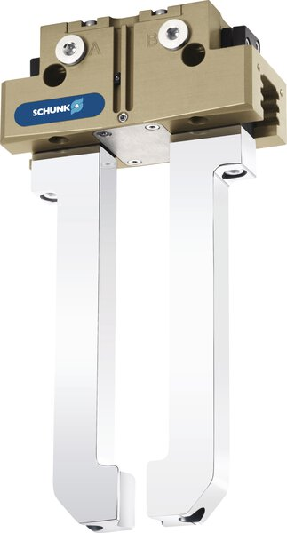
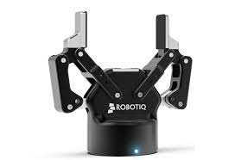
Actuators (Grippers)
Schunk Grippers
Robotiq Grippers
Grippers are used to grasp and manipulate objects.
They are used in material handling applications where the AGV/AMR is required to pick up and move objects.
Examples of grippers used in AGVs/AMRs are Robotiq Grippers and Schunk Grippers.

Slide 15
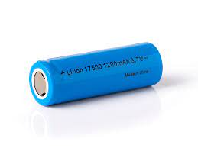
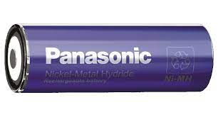
Power Management (Batteries & Charger)
Batteries: Batteries are used to provide power to the AGV/AMR. They are used for propulsion, steering, and powering the computing and sensing hardware. Examples of batteries used in AGVs/AMRs are Lithium-Ion batteries and Nickel-Metal Hydride batteries.
Chargers: Chargers are used to recharge the batteries used in AGVs/AMRs. They are used to maintain the AGV/AMR's operational time and ensure the reliability of the
Lithium-Ion batteries
Nickel-Metal Hydride batteries

Slide 16
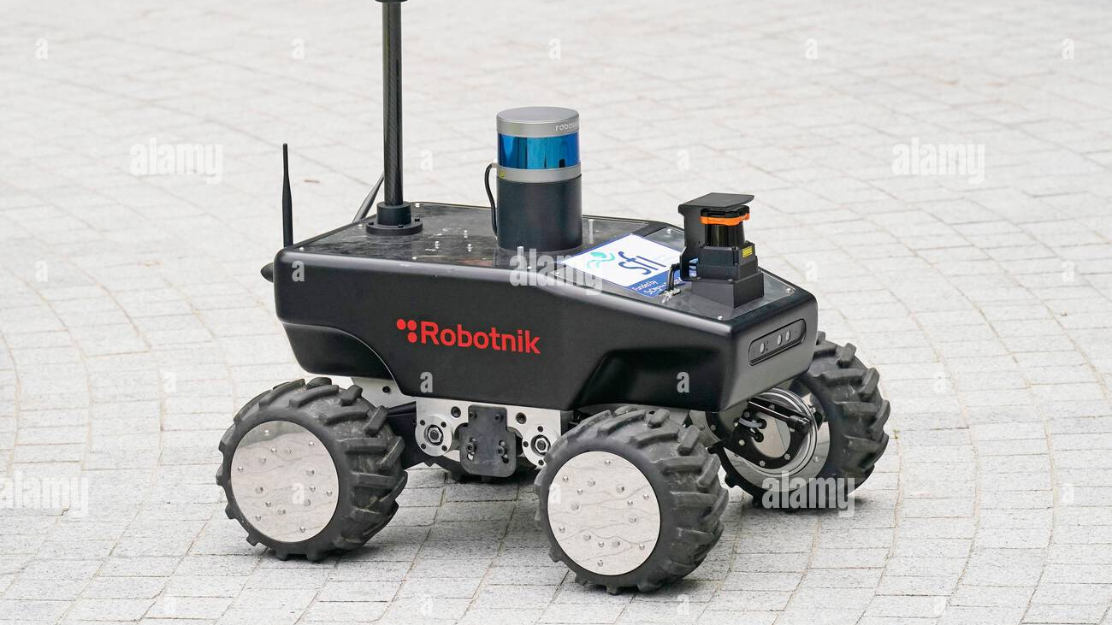
Summary
In conclusion, AGVs and AMRs are complex systems that rely on several hardware components to operate. These components include the computing and sensing hardware, power and energy storage hardware, locomotion hardware, and data transmission hardware. The computing and sensing hardware enable AGVs and AMRs to perceive their environment and make decisions based on that information. Power and energy storage hardware provide the energy needed to power the vehicles. Locomotion hardware enables the vehicles to move and navigate in their environment. Finally, data transmission hardware enables AGVs and AMRs to communicate with the control system and exchange information with other devices in the environment. The selection of hardware components depends on the specific requirements of the application and the environment in which the AGV/AMR operates. By carefully selecting and integrating these hardware components, AGVs and AMRs can perform a wide range of tasks autonomously, improving efficiency and safety in various industries.

